Slide 1
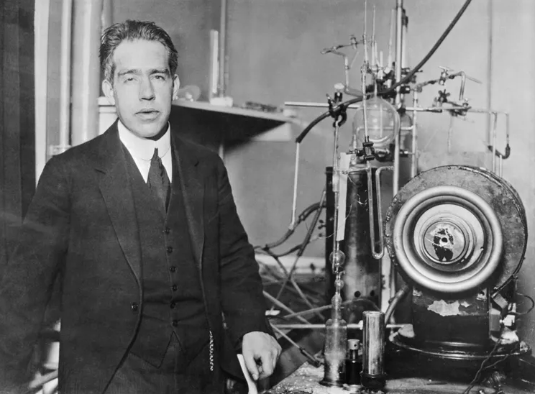
1.
Two key outcomes of his atomic model.

Slide 2
2.
An element M has three naturally occurring isotopes with consecutive mass numbers (A - 1), A, and (A + 3). In a natural sample, the ratio of their occurrence is 2 : 5 : 3, respectively. If the measured average atomic mass of the sample is 12.7u, set up the linear equation to determine the value of A.

Slide 3
3.
Write the Electron distribution, Valency, Valence electron of Cl, Ar, B
4. Write two advantages of Paperfuge.
5. Write the Dispersed phase and dispersion medium for:
Shaving cream and Milk

